Slide 1
Dual Enrollment Guide
Aimee Busquet, M.S. M.Ed.
Associate Dean for Accelerated Learning
Office of Accelerated Learning

Slide 2
Dual Enrollment
Terminology
Traditional Dual Enrollment: Students may take a maximum of ten (10) Dual Enrollment credits in the fall, spring, and summer terms. The term Dual Enrollment is for classes taken by high school students on our college campuses either online or in person.
Concurrent Enrollment: College level courses taught by credentialed high school teachers at the various high school sites. Must be kept to the same rigor and policies as the college version of the course.
Early Admission: Early Admission is a form of Dual Enrollment which allows eligible high school senior students to enroll in (12-15) Dual Enrollment credits per fall and spring of their senior year. Students must have college level test scores, a 3.5 GPA, and submit a Form C. Early admission students may only attend college courses and may not be enrolled in any high school classes. They cannot participate in the running for a distinction (Valedictorian or Salutatorian)
Lastly, they must have completed all requirements for high school graduation or have one or more of the following courses remaining:
1 credit of English and/or
1 credit of Math and/or
0.5 credit of Economics and/or
0.5 credit of American Government

Slide 3
Dual Enrollment Eligibility
Minimum 3.0 unweighted high school GPA to enter the program.
Maintain a 3.0 unweighted high school GPA and a 2.0 college GPA
Have taken a placement test that is less than two years old
( ACT, SAT, or PERT)

Slide 4
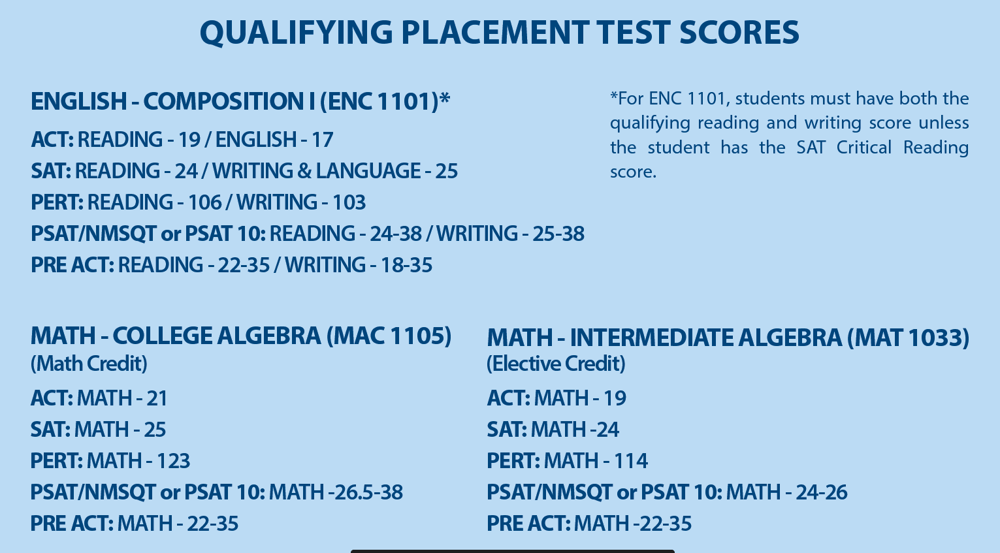
Dual Enrollment Placement Testing
In order to begin the Dual Enrollment program, students must provide test scores.
HCC accepts the PERT, ACT, or SAT.
Test scores must be less than two years old.
Students will not need a set test score in order to begin Dual Enrollment, but a college-ready test score is needed for specific courses.
The PERT exam may be taken up to three times.
It is free the first time and $10 per section each subsequent time.
PERT exam may be taken at any HCC campus or online.
Must make an appointment with a campus Testing Center.

Slide 5
Transferability of Dual Enrollment Courses
Dual Enrollment will transfer to the Florida State Universities System (SUS) due to the Florida Common Course Numbering System and the statewide articulation agreement.
If students do not, upon high school graduation, attend the same college or university where they earned their dual enrollment credit, the application of transfer credit to general education, prerequisite, and degree programs may vary at the receiving institution.
Florida private schools look at the individual course to decide if and how the credit will transfer.
For out of state schools and private schools you will need to check with the individual schools to inquire whether dual enrollment credit will be accepted to transfer.

Slide 6
DE students are to handle all communication for themselves. Parents should not use the student’s email to communicate with the professor.
Students are responsible for checking their schedules and HAWKMAIL regularly.
Our DE office cannot speak to parents until the student has signed a FERPA release.
DE students are not permitted to pay for additional courses while in the DE program.

Slide 7
Essential Points to Share with Students about their Grades
Dual Enrollment is the start of their college transcript.
These grades can affect your college admissions, Bright futures, and financial aid eligibility. Remind students to be aware of their college GPA.
Students that earn below a “C” or withdrawal from a course will be removed from the DE program. Students are permitted to petition the DE office one time requesting to remain in the program.
If a student’s high school GPA drops below 3.0, they will be removed from the DE program.

Slide 8
Drop/Add Week is the only time students may change their schedules.
A WN grade is a withdrawal for non-attendance given by a professor.
A W grade is when a student elects to withdraw from the course. This can only be done during a certain window of time. A W will remain a permanent part of the college transcript, counts as an attempt, and will not be used in GPA calculations.

Slide 9
Dual Enrollment Application Process
Step 1 – Students need to consult you first.
Step 2 –Online Dual Enrollment Application
Step 3 –Take PERT or submit ACT/SAT scores.
Step 4 – Submit Form B and Summary form
Step 5 – Course Schedule Adjustment via Etrieve
Step 6 – Order Textbooks
Step 7 – Self-Identify if they need any accommodations. 504 plans accepted. IEPs are not accepted.

Slide 10
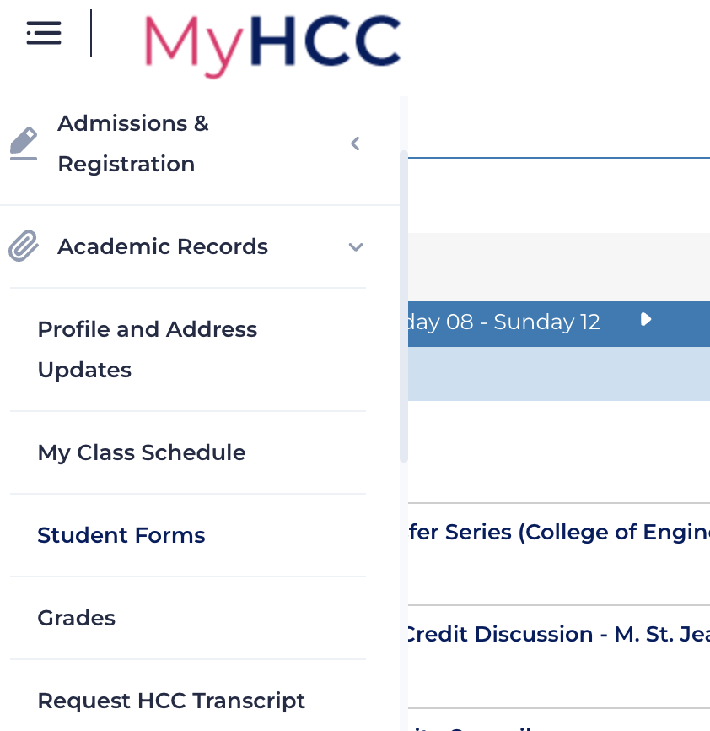
MyHCC Student Forms
Course Schedule Adjustment
Dual Enrollment PERT Request
FERPA Release

Slide 11
Academic Student Resources
Library and Academic Support Services -
Free On Campus and Online Tutoring -
Live Online Support Center
Career Services-
Academic Advising -

Slide 12
Concurrent Enrollment on
High School Sites
APCs submit Course Offering Sheets
Make sure all students apply and obtain an HCC ID Number.
Submit Rosters by the first two weeks of classes.
Once all rosters have been checked for accuracy, students will be enrolled.
Submit Grades at end of term.

Slide 13
IMPORTANT DATES:
The portal is open for petitions and will remain open until May 19th.
The portal is also open for Summer 2023 paperwork submission until April 7th at 5pm.
Search for Classes feature- Summer courses will be open for viewing on Monday, March 13th.
• Summer Registration:
Current students w/ 30+ credit hours can begin registration on March 21, 2023.
• Current students w/ 1-29 credit hours can begin registration on March 27, 2023.
• New Dual Enrollment students can begin registration on April 3, 2023.
Fall Portal opens April 24th and closes May 19th

Slide 14
Any Questions?

